Slide 1
Alpha Lambda Delta
Interest Meeting: March 9th, 2016

Slide 2
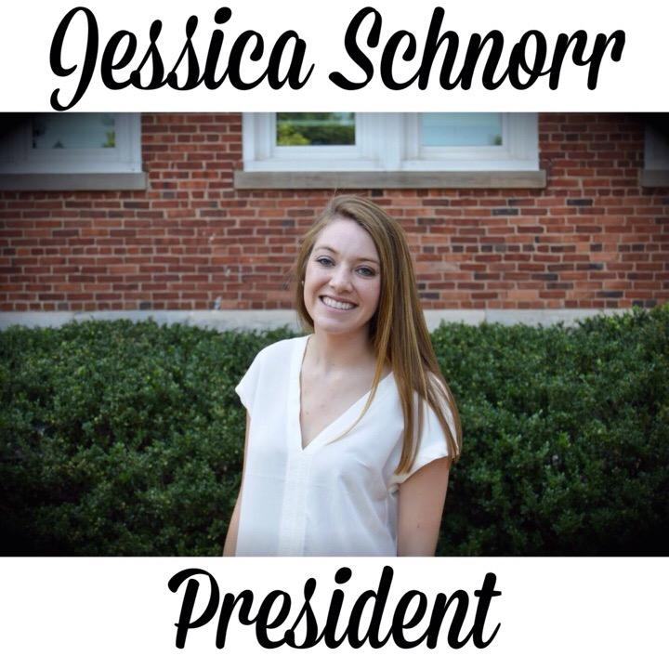
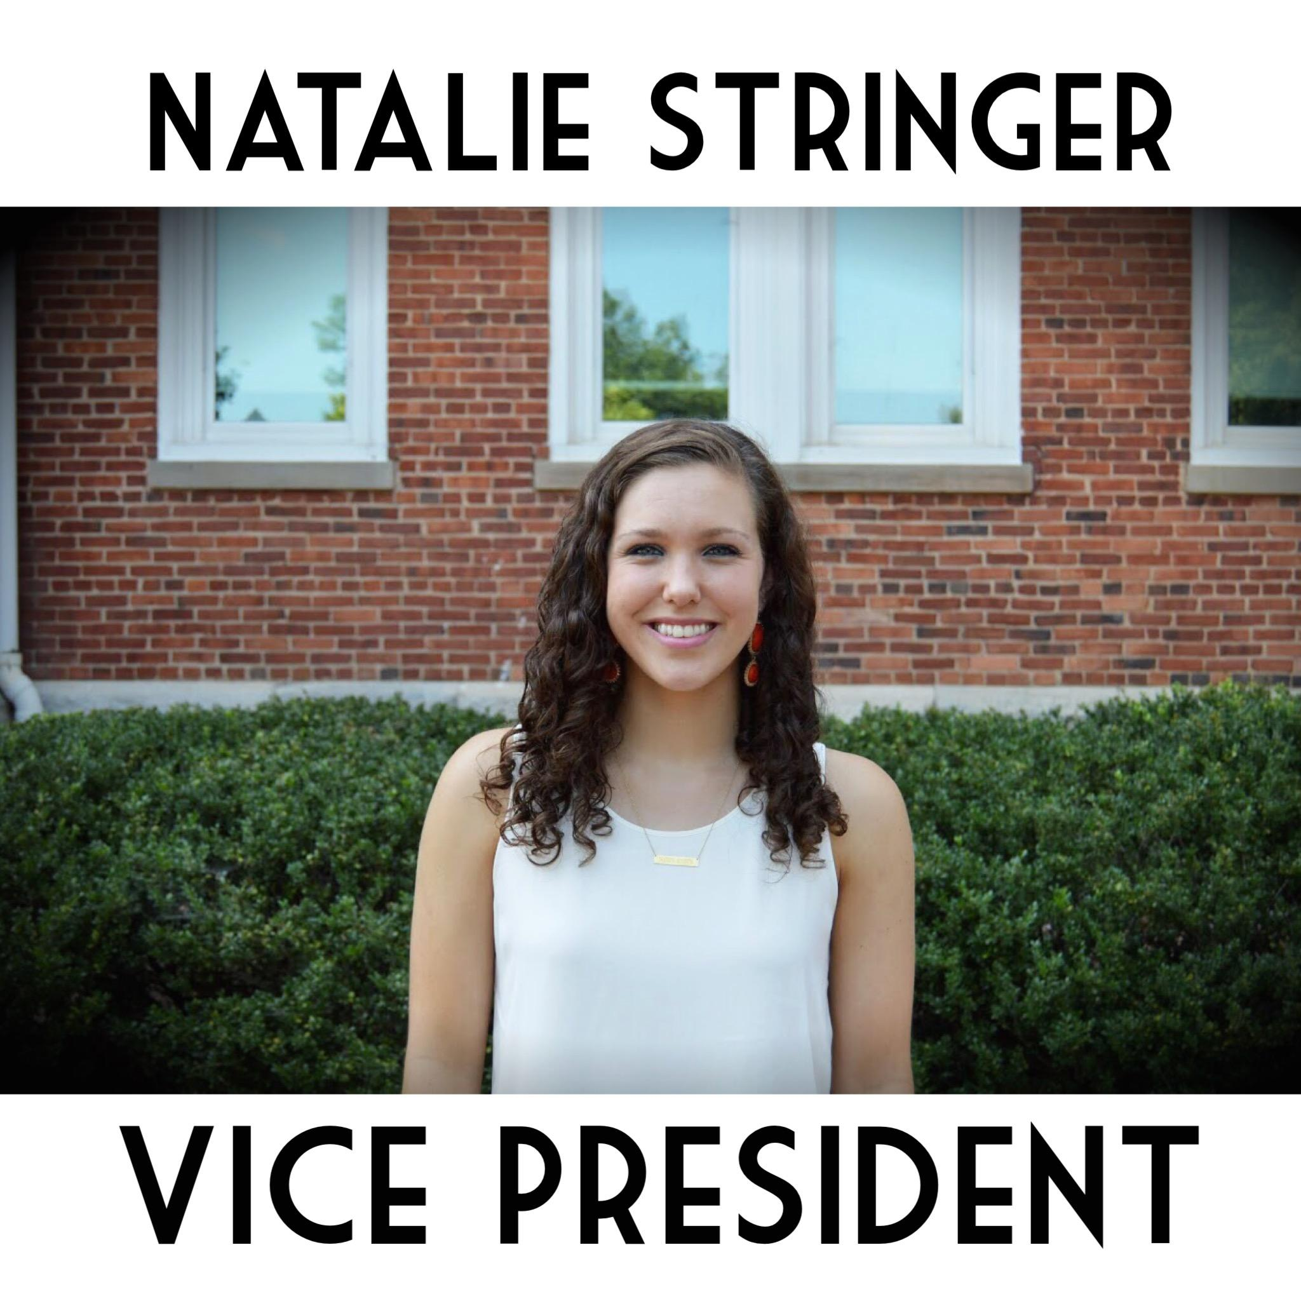
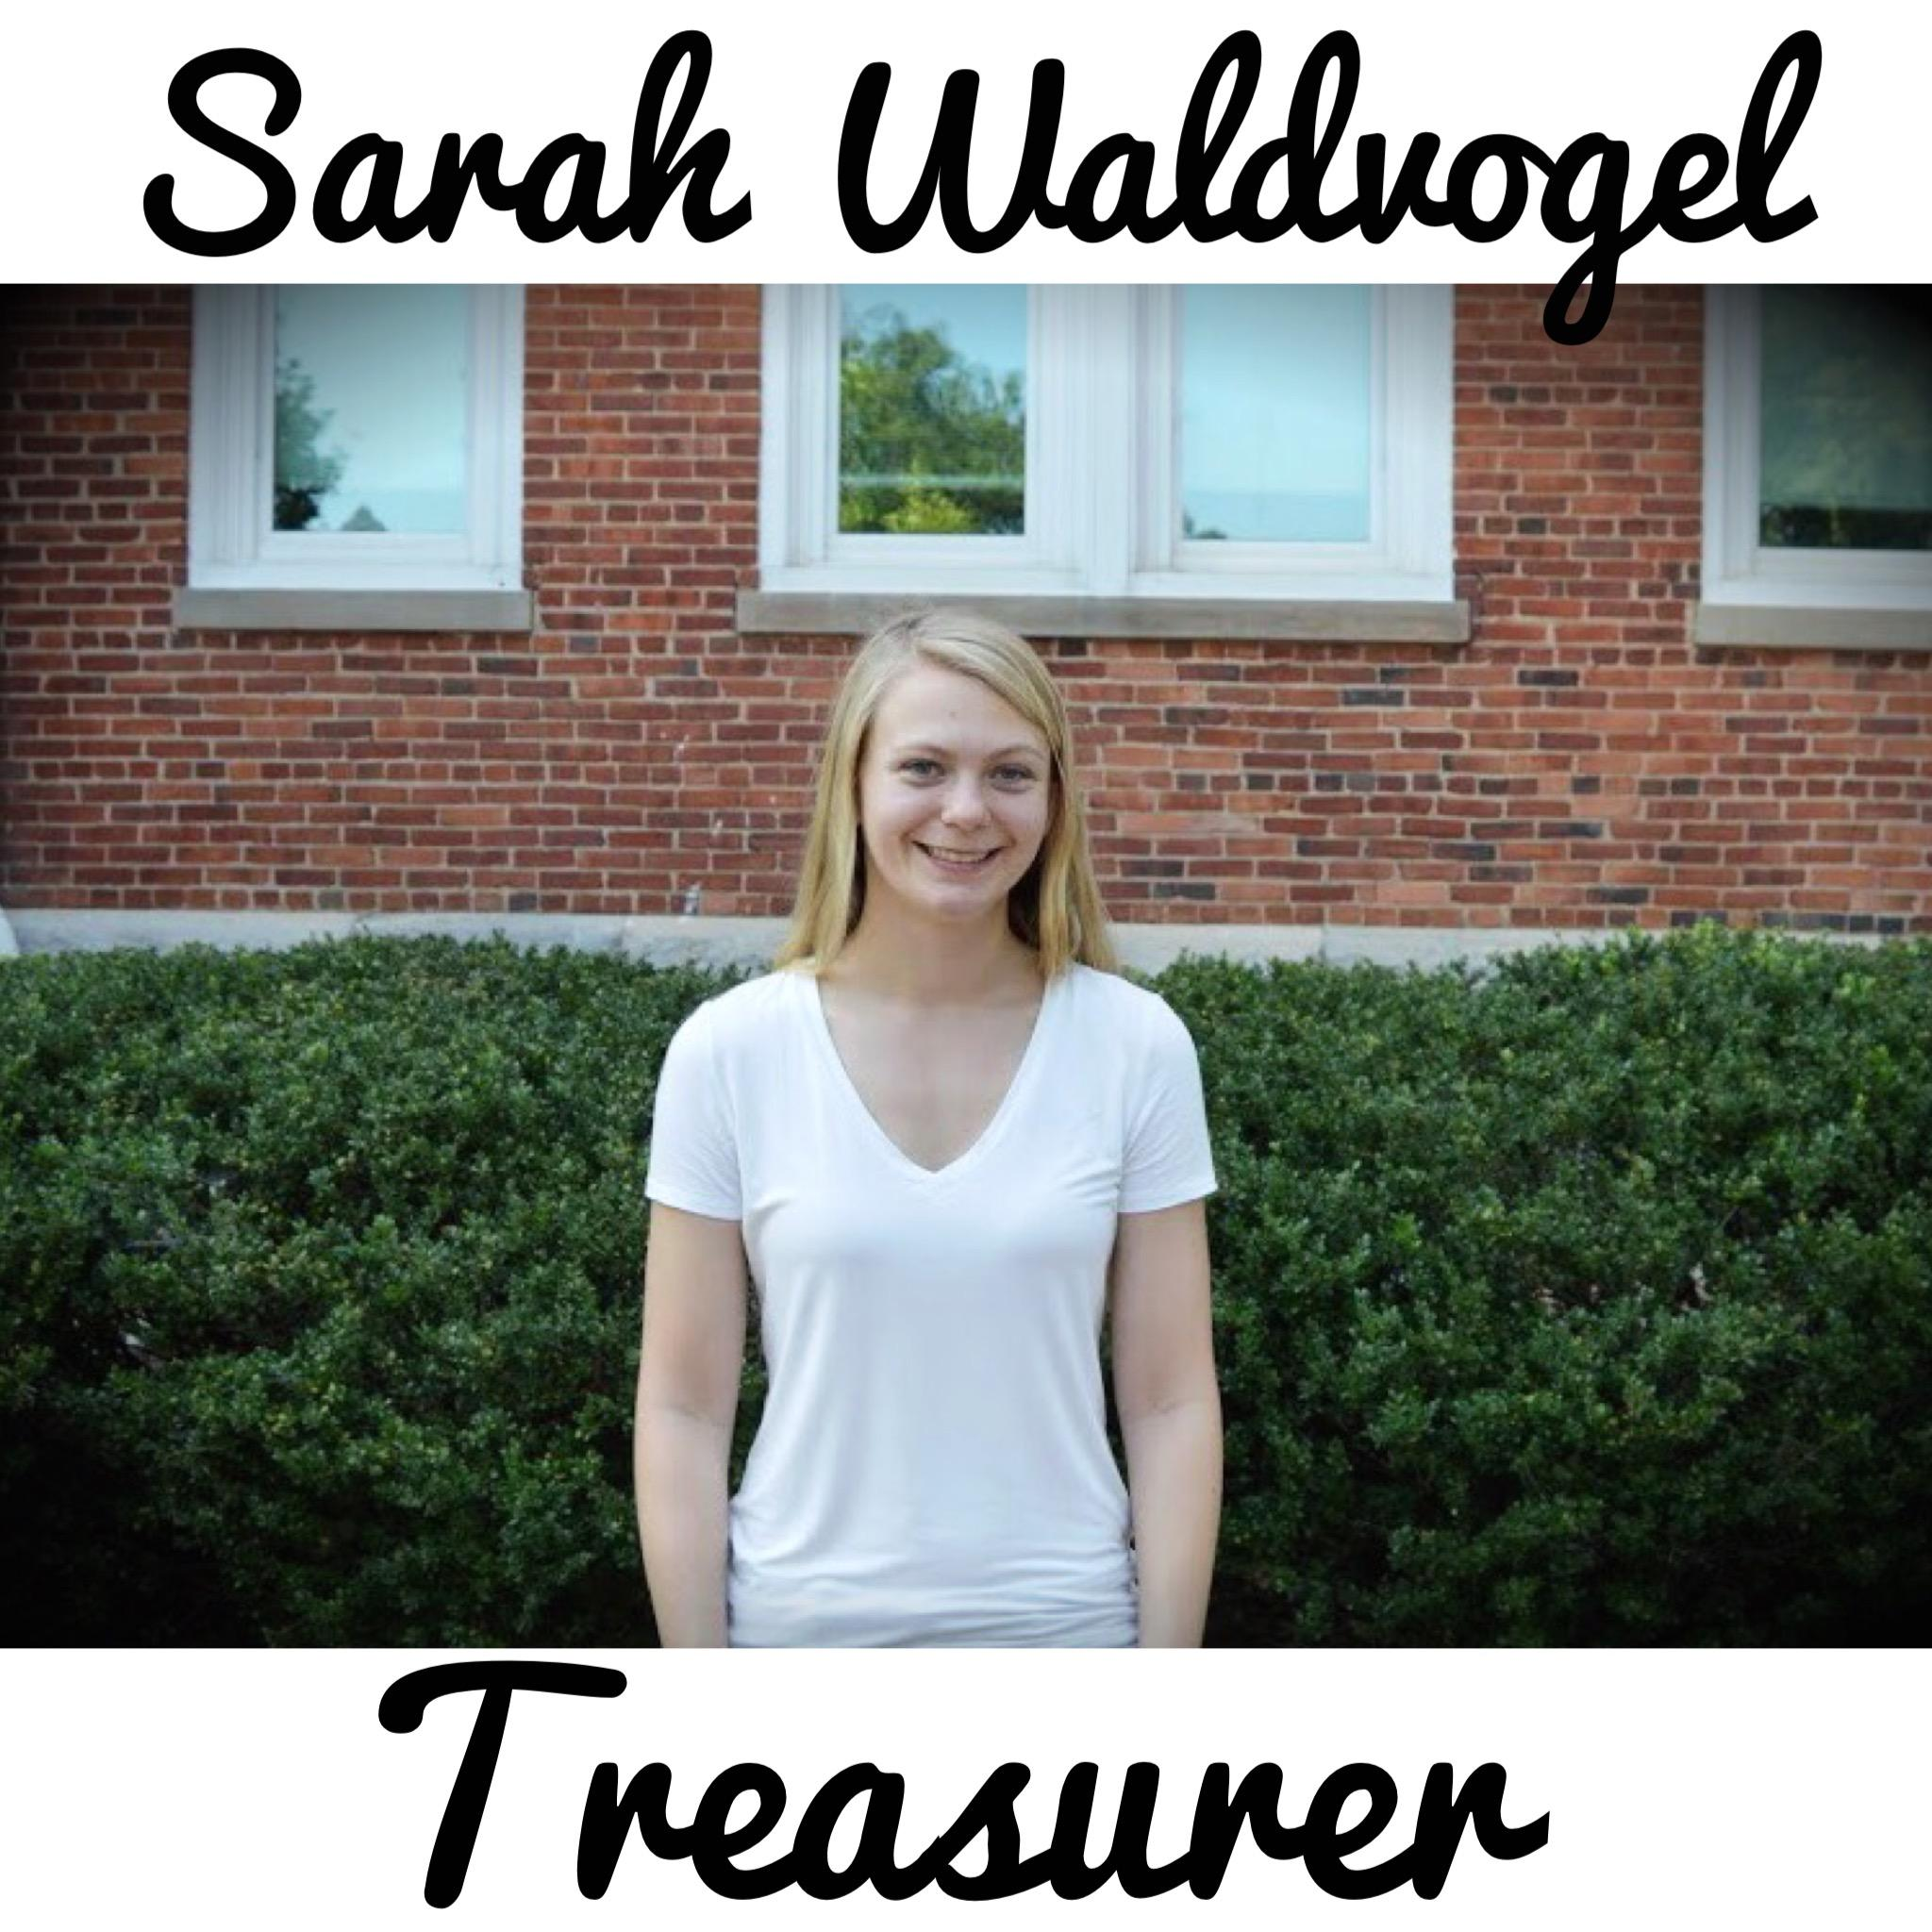
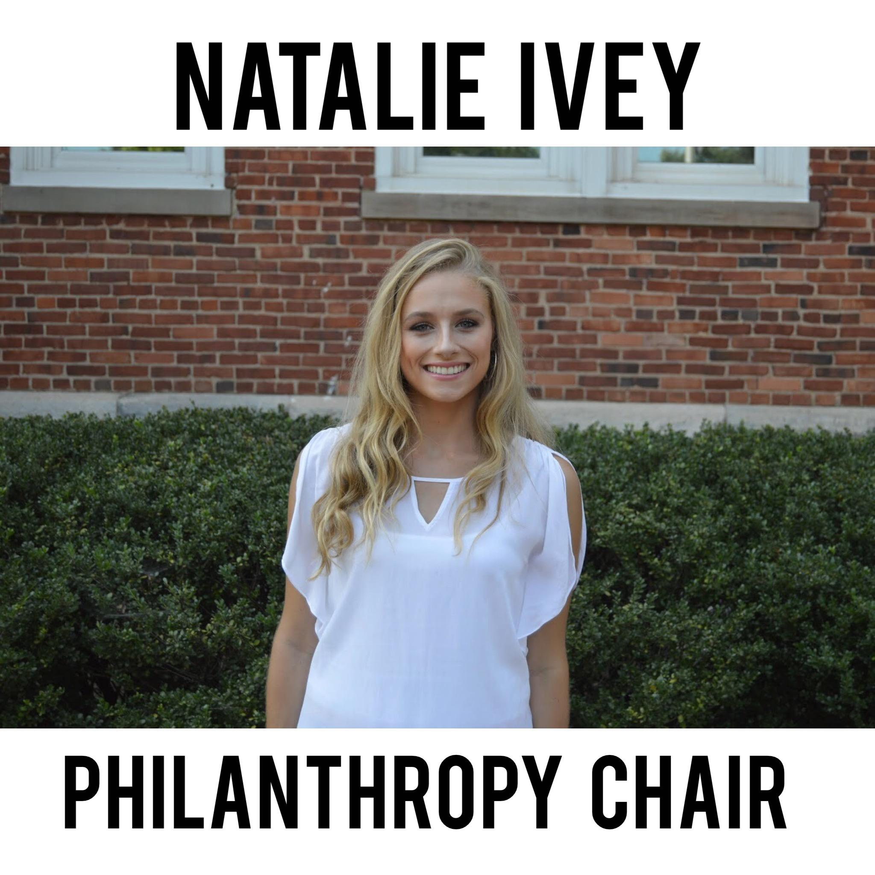
Exec: 2015-2016

Slide 3
Who are we?
Alpha Lambda Delta is an honor society for students who have achieved a 3.5 GPA or higher AND are in the top 20% of their class during their first year of college (that’s you!!)

Slide 4
Alpha Lambda Delta is dedicated to academic excellence, service, and community development.

Slide 5
Hazing
Prevention
Week

Slide 6
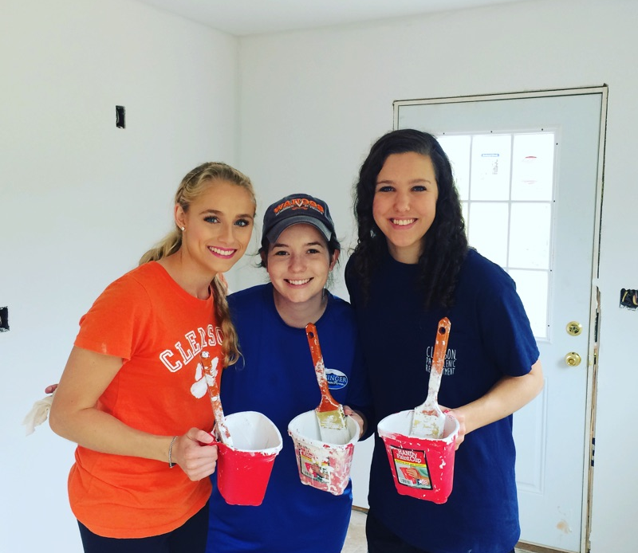
Habitat for Humanity

Slide 8
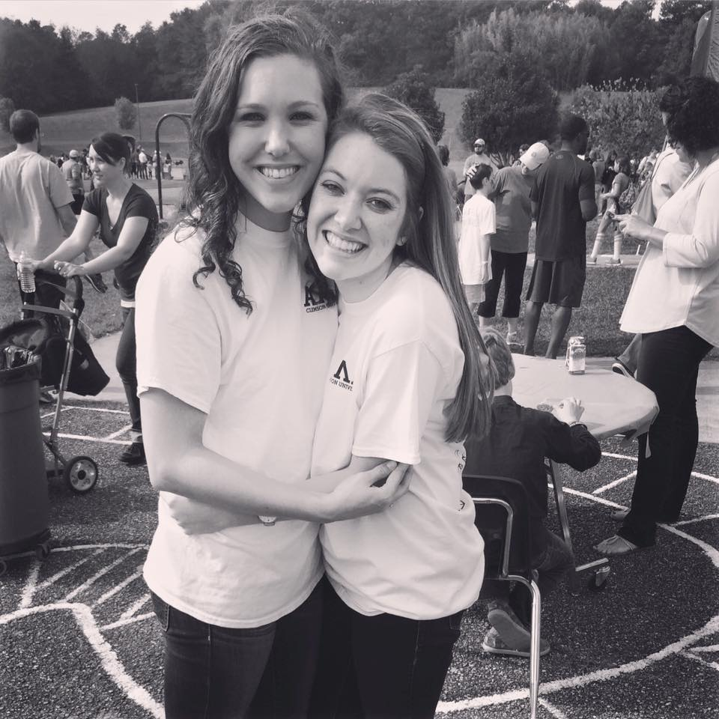
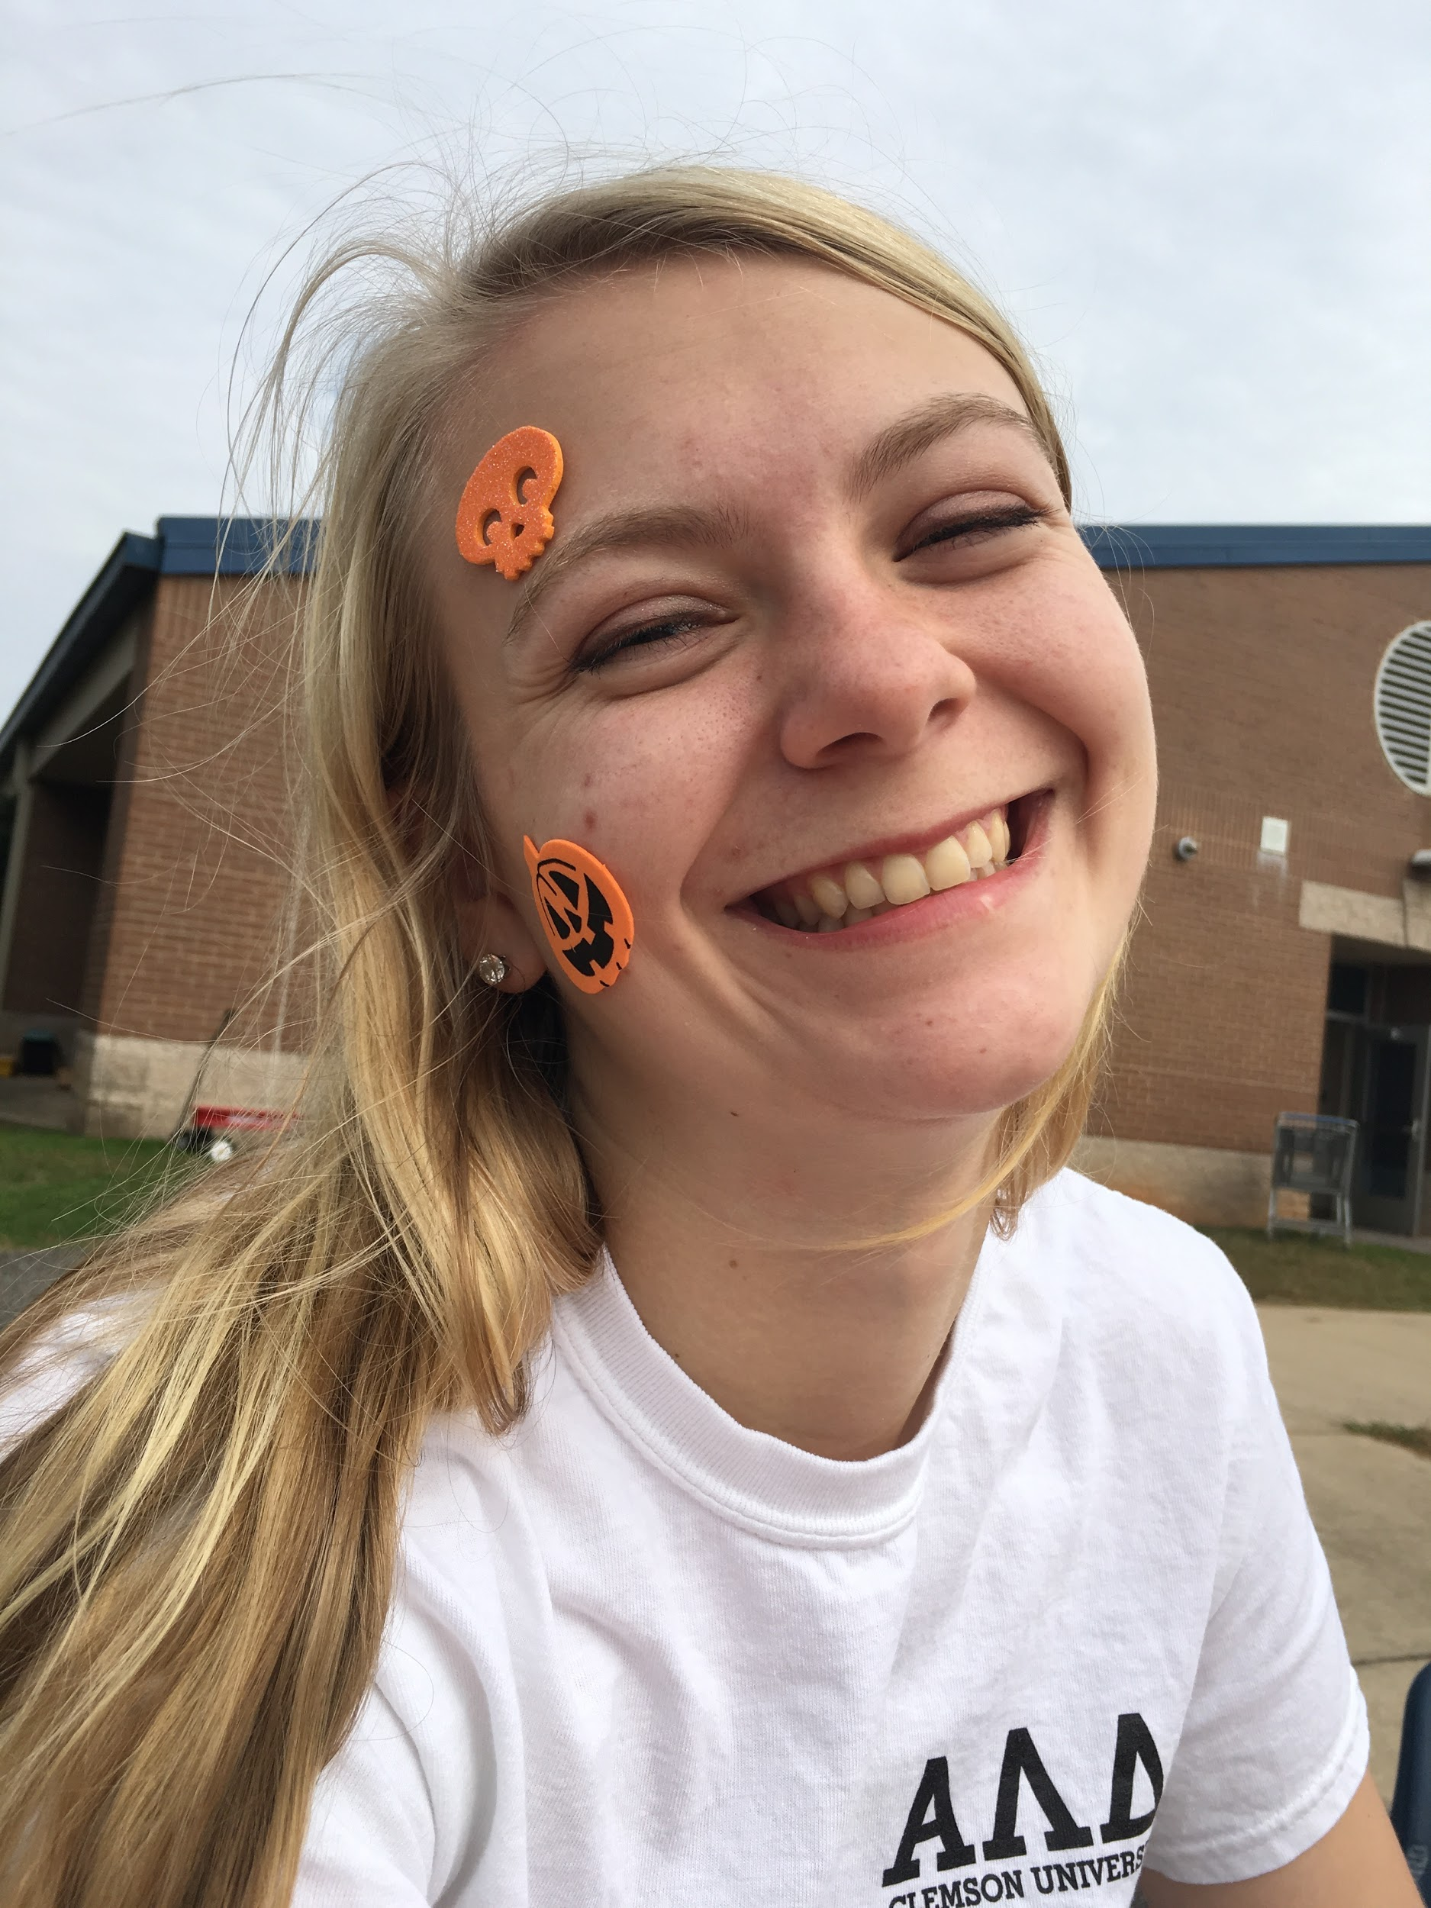
Fall Festival With Clemson Elementary

Slide 9
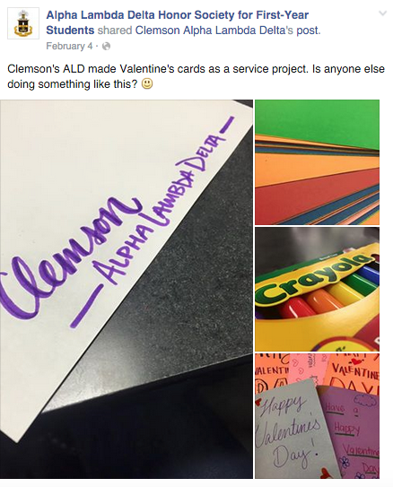
Smaller Service Projects:
Valentine’s Day Cards for GHS!

Slide 10
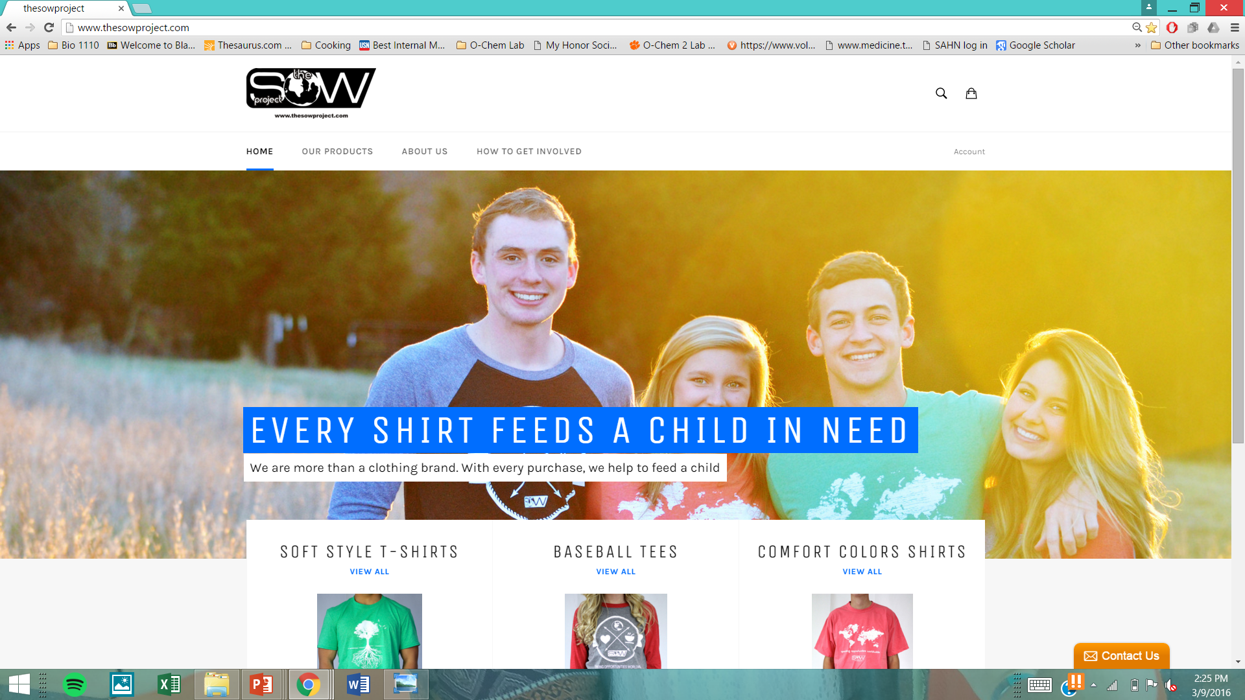
2015-2016 Philanthropy: The SOW Project!!
“Sparking Opportunities Worldwide”
Each shirt sponsors an orphan
Current Project: Dominican Republic
Future Projects: Children’s home in Nicaragua and a Community Center in Kenya

Slide 11
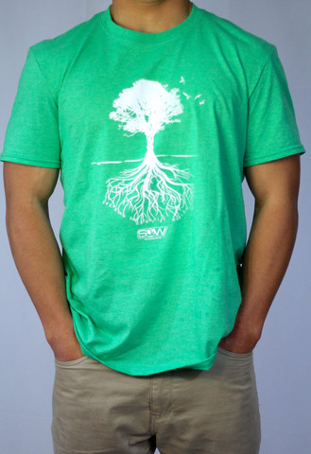
SOW Project Shirts
http://www.thesowproject.com/

Slide 12
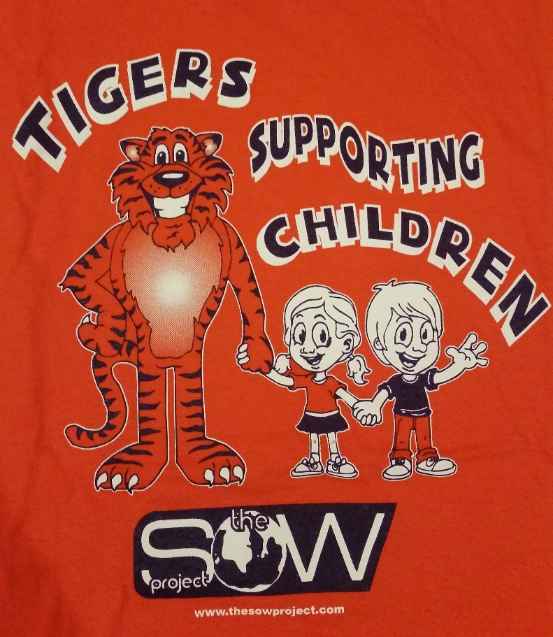
SOW Excited for… Philanthropy
Proceeds Night at Groucho’s Deli went very well! All money supporting SOW
Next fundraiser will be a Grilled Cheese sale in downtown Clemson
Will be tabling on library bridge to sell shirts

Slide 14
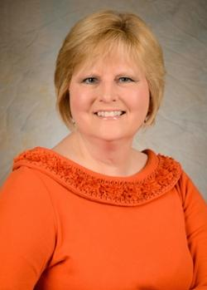
The People of ALD
New Advisor!
Susan Falendysz
Student Services
Program Coordinator
Worked with Clemson
for 12 years
Housed in the Calhoun
Honors College

Slide 15
FAQ

Slide 16
Is this only for freshmen?
ALD accepts first year students based on their scholastic achievement
Lifetime membership (all 4 years!)
We have active members from all four classes at Clemson!

Slide 17
Can you tell me about dues?
Lifetime fee is $50
Clemson ALD receives 50% of dues for programming and events
We do several fundraising events each year, both large and small scale
We use this money to fund our own events and service projects
We also give money to support other organizations on campus (SOW!)

Slide 18
Can you tell me about the benefits?
Scholarship Benefits!
National organization provides opportunities for members from all chapters to apply for scholarships
Jo Anne J. Trow Scholarships - 36 awards ranging from $1000-$6000 to fund a student’s junior year of study
James G. Stemler Study Abroad Scholarships - 20 awards ranging from $1000-$2000 to pay for study abroad
ALD Graduate Scholarships - 24 awards ranging from $3000-$7000 for graduate or professional study

Slide 19
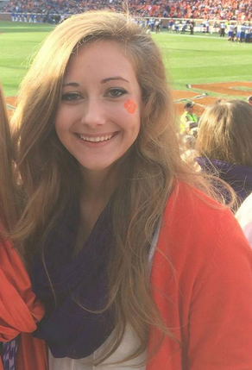
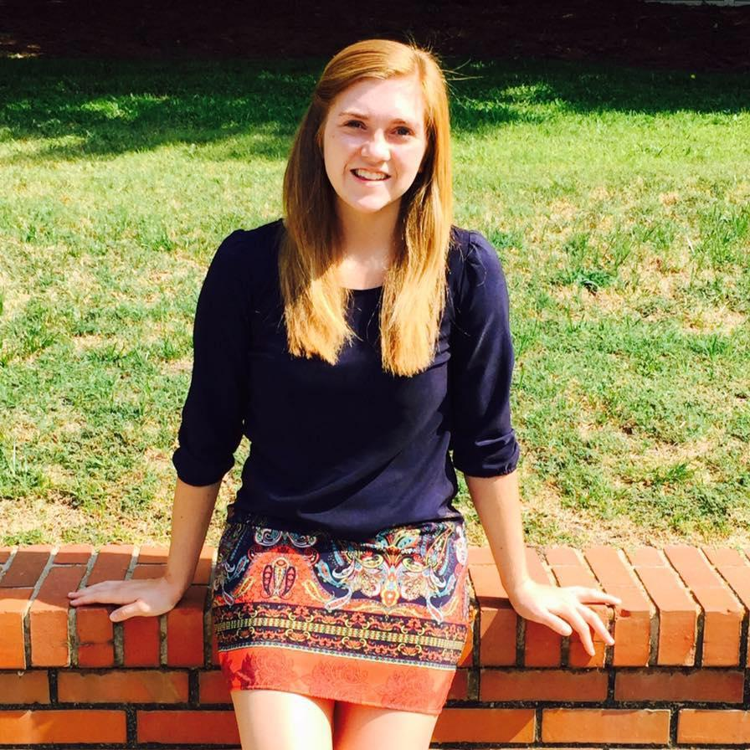
CLEMSON HAD TWO RECIPIENTS OF ALD’s TROW SCHOLARSHIP!!!
Laura Chopp
Emily Smail

Slide 20
Leadership Benefits
Exec Applications and Interviews
At the end of this month/March
Come talk to us about any of our positions!
6 positions on Exec...
Connecting you on campus with other organizations!

Slide 21
Service Benefits! (Looking Forward)
Habitat for Humanity: APRIL 2ND! 9 am to 12 pm. Activity and Location TBA.
SOW T-shirt Sales: MARCH 29TH, 1-3 pm on library bridge! (Also grilled cheese sale)
Relay For Life (working on a partnership with AED): APRIL 15th, 6pm-1am!
Clemson Elementary Fall Fest - Fall 2016!

Slide 22
Would I lose membership if my grades drop or I become too busy?
NEVER!
You’ve worked so hard to get in, so why would we ever kick you out?
Time commitment/involvement is as much or as little as you make it
We normally meet once a month

Slide 23
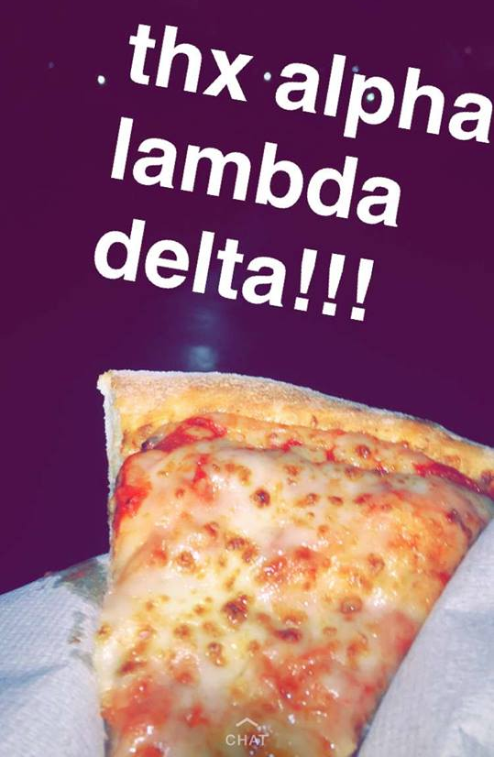
Do you really have free pizza at every meeting?
YES.
Always.

Slide 24
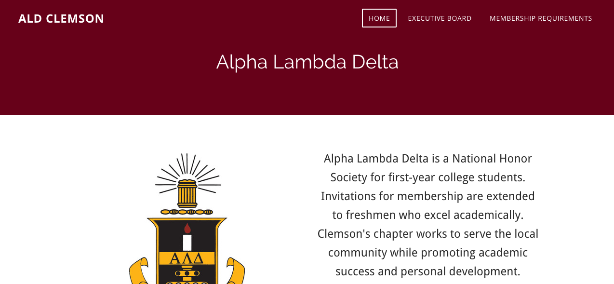
Place your screenshot here
Connect With Us!
http://aldclemson.weebly.com/

Slide 25
PR Director’s Updates
@ClemsonALD @clemson_ald
www.facebook.com/ClemsonALD
Follow us for updates on meetings, community service events, and opportunities to get involved on campus!

Slide 26
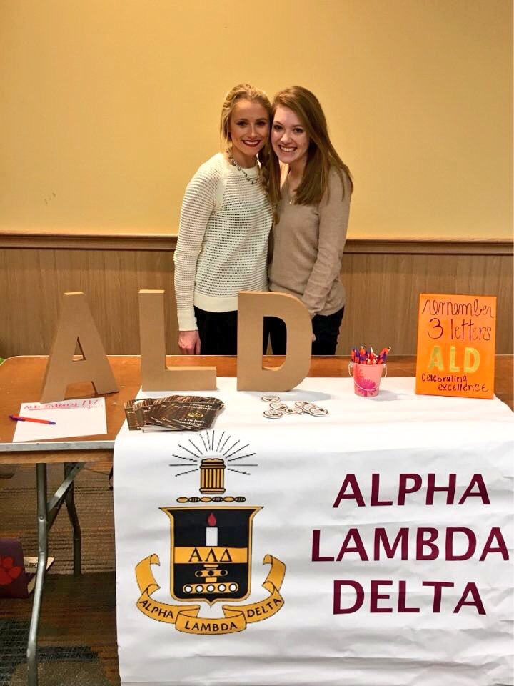
Thanks!
Any
questions?

